Slide 1




Supporting pupils with sensory and physical needs
 | OUTREACH SERVICE SUPPORTING SCHOOLS. ENABLING INCLUSION.
Returning to school post lockdown

Slide 2
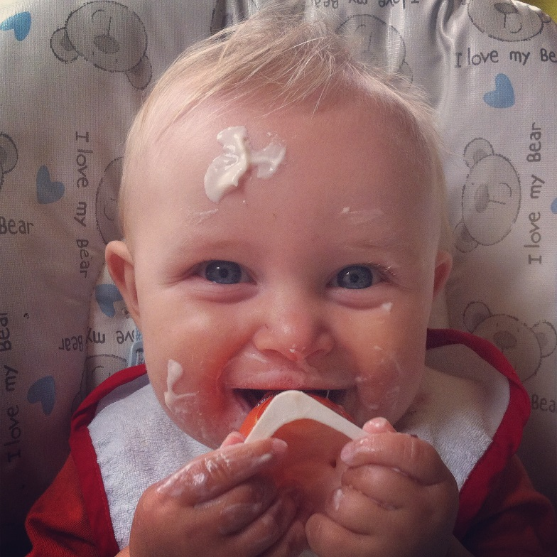
What are the senses?
Some other senses
5 commonly known senses
Sight
Hearing
Taste
Smell
Touch
Chronoception
Thermoception
Nocioception
Interoception
Proprioception (cup)
Vestibular system (lift)
What might it feel like if one of these senses was over / under reactive?
What behaviours might be displayed as a result?
Notes:
Interoception helps you understand and feel what’s going on inside your body. For instance, you know if your heart is beating fast or if you need to breathe more deeply. You’re able to tell if you need to use the bathroom. You know if you’re hungry, full, hot, cold, thirsty, nauseated, itchy or ticklish.
Proprioception – awareness of position and movement of the body
Vestibular system – coordinating movement with balance

Slide 3
Seeking
Reducing
Gross motor movements
Rocking
Chair swinging
Stamping / running
Out of seat
Biting
Slapping
Chewing
Tapping / Rubbing
Crawling
Covering ears
Hiding
Escape
Jumper over face
Self stimming
Crying (overwhelmed)
Removal of displays
Switching off devices
Fidgeting with clothing / stripping off!

Slide 4
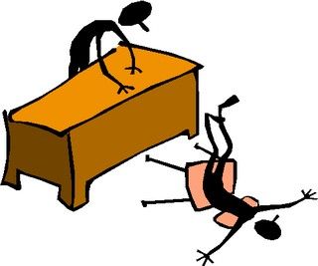
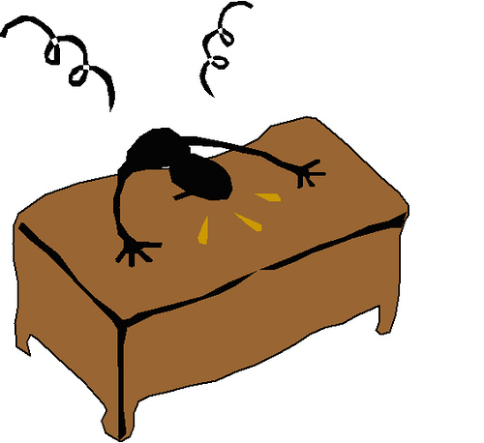
How might sensory seeking behaviours be displayed in older children?
Out of seat
Barging
Whistling / Humming
Chair swinging
Flight behaviours
Corridor sliding!
Hood up
Tapping / leg jigging
 | WOLVERHAMPTON OUTREACH SERVICE SUPPORTING SCHOOLS. ENABLING INCLUSION.

Slide 5
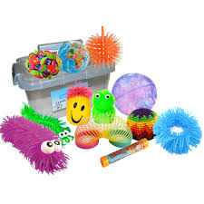
Sensory needs
Key support mechanism will be patience
Pupils will need to adapt to change in environment at own pace and in own way
Not doing so could result in ‘meltdown’
Communication with parents is vital- sharing of strategies
Is there an item that can support transition e.g. comfort blanket?
Maybe a phased return
Risk assessment
 | WOLVERHAMPTON OUTREACH SERVICE SUPPORTING SCHOOLS. ENABLING INCLUSION.

Slide 6
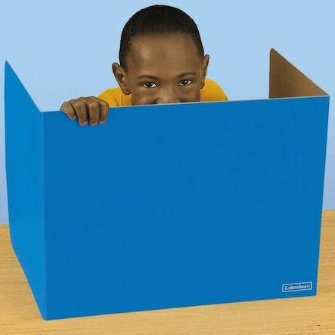
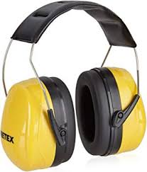
Sensory avoiders
Return to busy classroom may be overwhelming
Pupils need access to a ‘get out card’
Safe space or an area within the classroom
Resources- ear defenders, desk screen etc
For older pupils creating an effective communication system
New issues that were not previously evident because of changes in environment/ smells/ volume
May need to explore alternative strategies for keeping pupils safe e.g. handwashing issues, changing classroom position

Slide 7
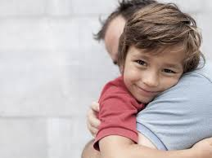
Sensory seekers
Social distancing issues
Importance of risk assessment and staff awareness. Are staff comfortable with these needs?
Safety is paramount in this situation
Providing sensory alternatives to touch
Appropriate PPE equipment

Slide 8
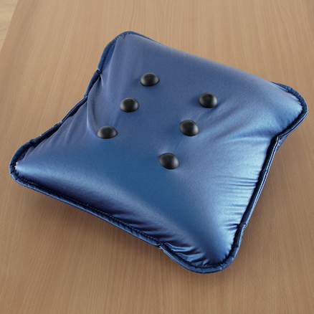
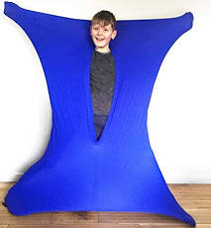
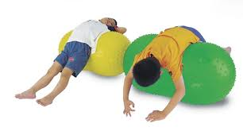
Alternative sensory input
Rolling a gym/ peanut ball over the pupil to create some deep pressure
Provide the pupil with weighted items to replicate the feel of a human touch such as a backpack filled with heavy items, weighted bean bags, weighted blankets (always seek advice from at Occupational therapist for appropriate weight guidelines)
Use of a lycra sock or wrapping the pupil in blankets
Use of a large stuffed toy etc for the pupil to hug
A vibrating cushion

Slide 9


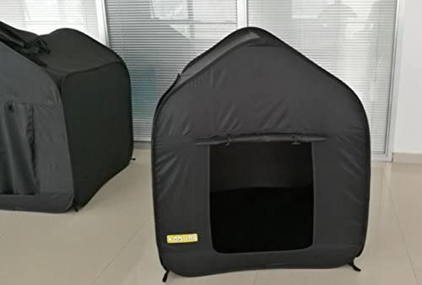
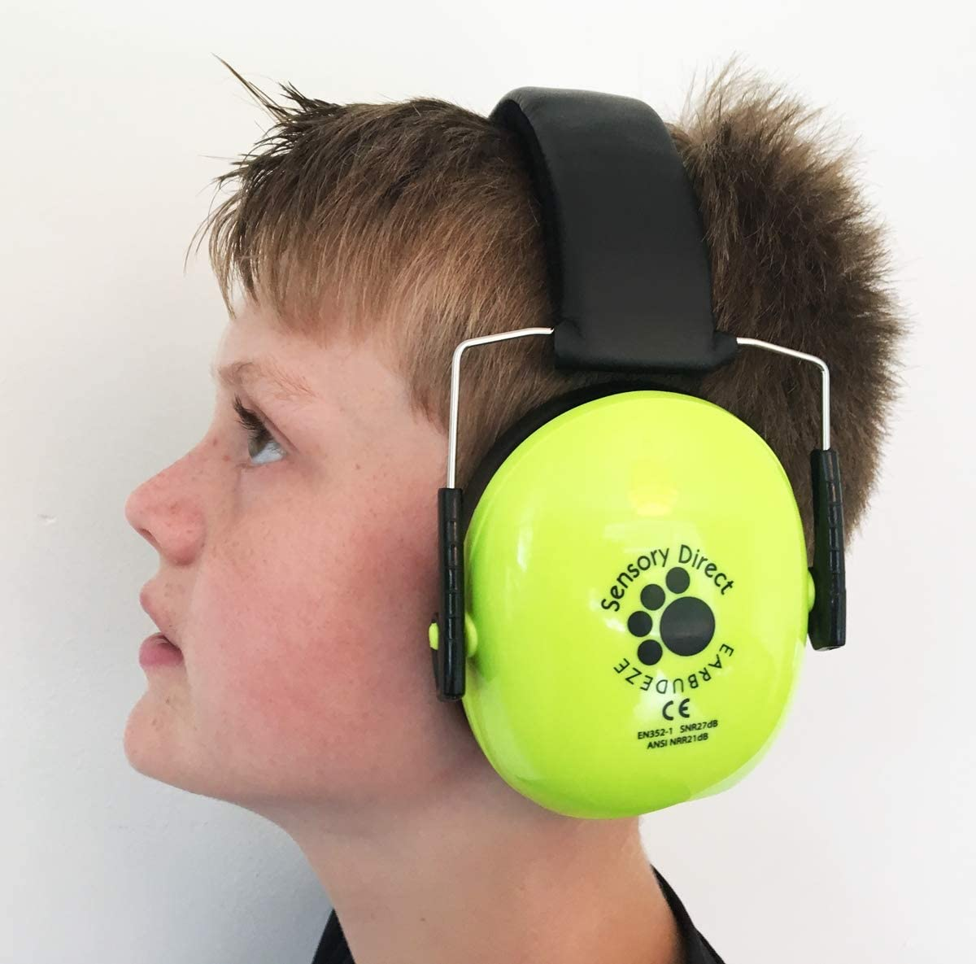
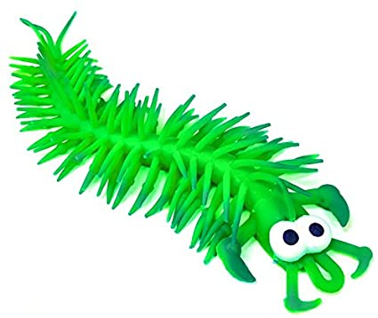
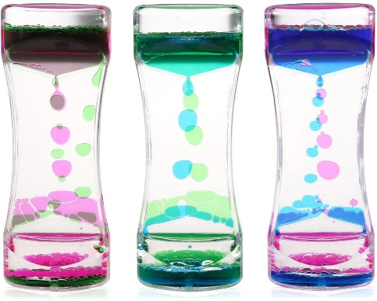
Age appropriateness
 | WOLVERHAMPTON OUTREACH SERVICE SUPPORTING SCHOOLS. ENABLING INCLUSION.

Slide 10
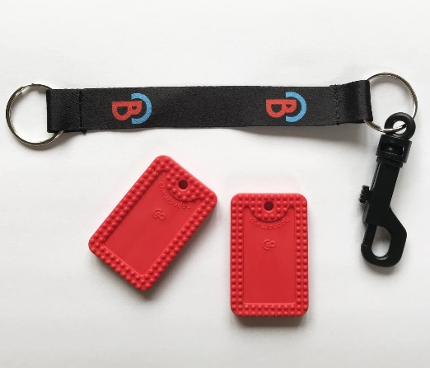
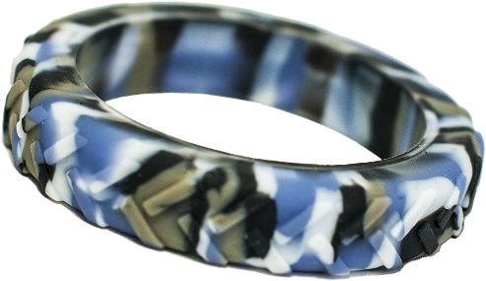
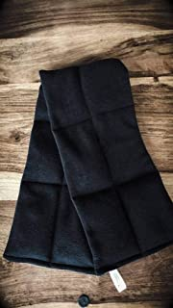
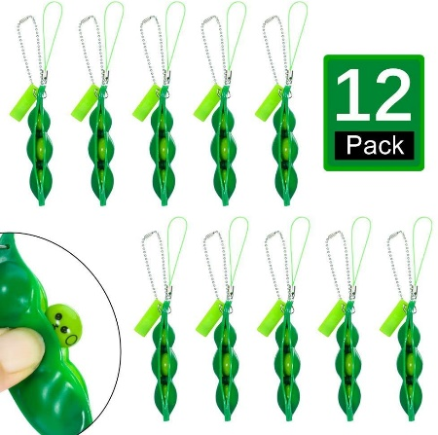
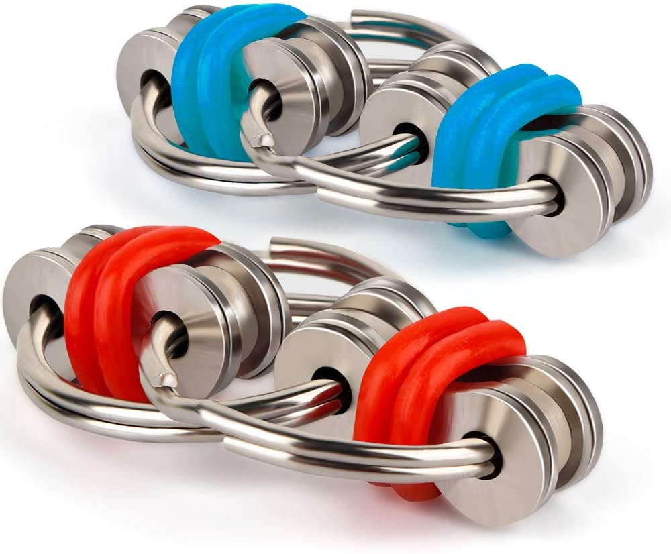
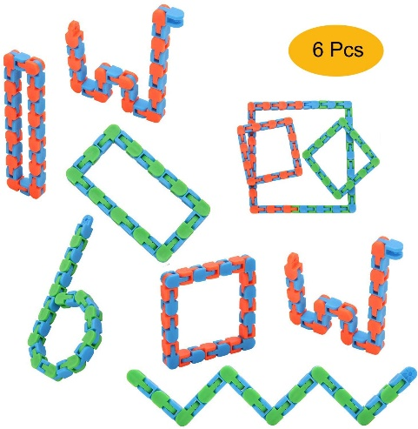
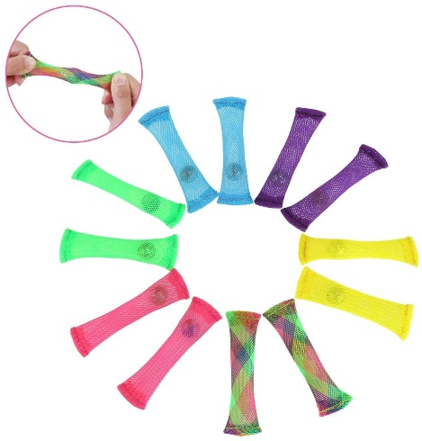
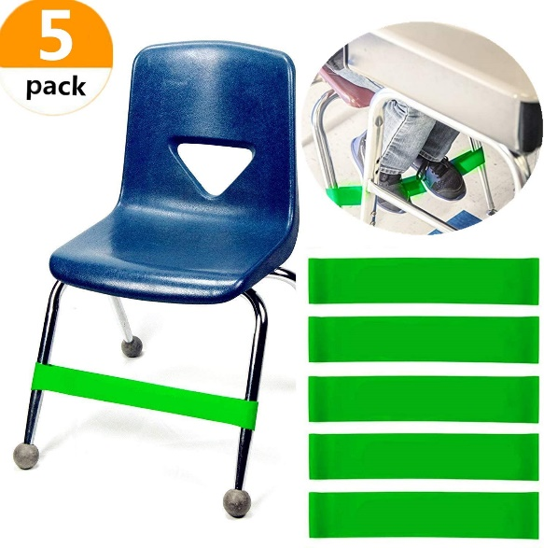
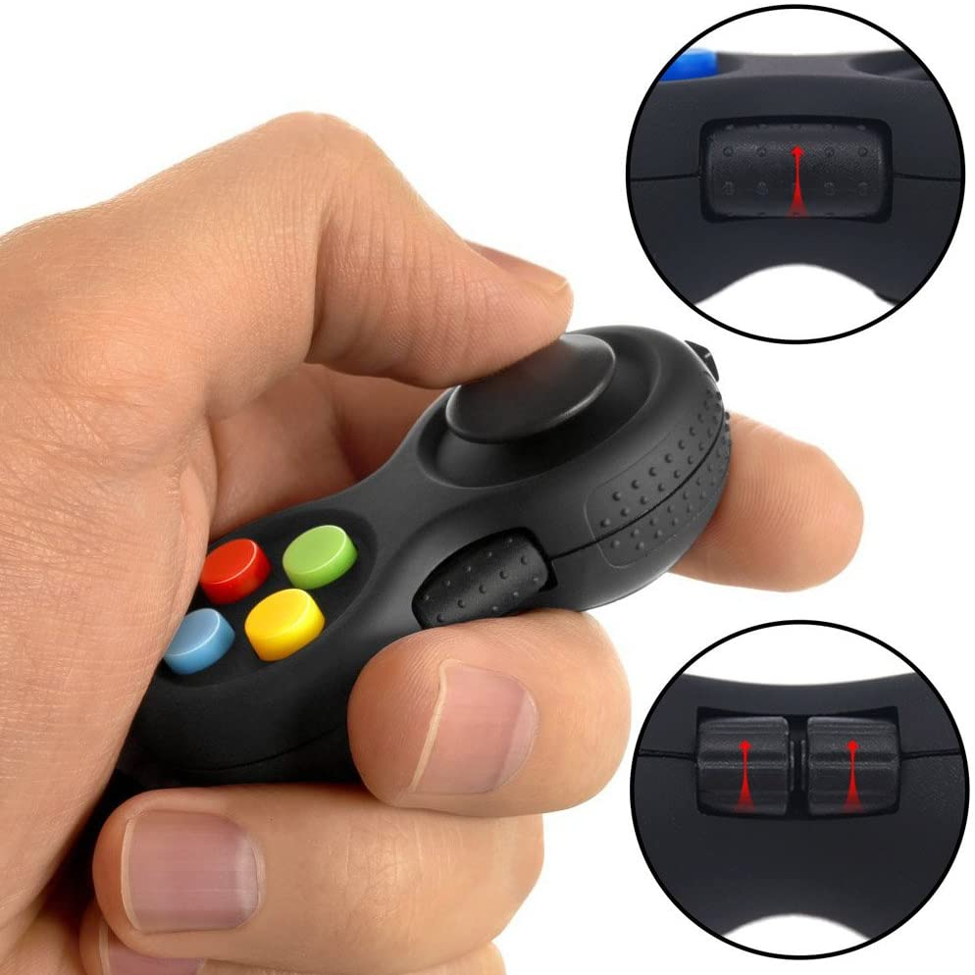

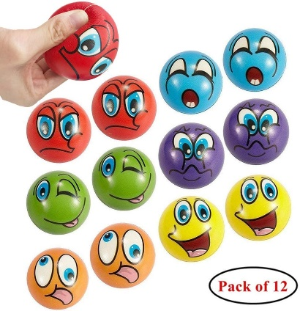
Age appropriateness

Slide 11
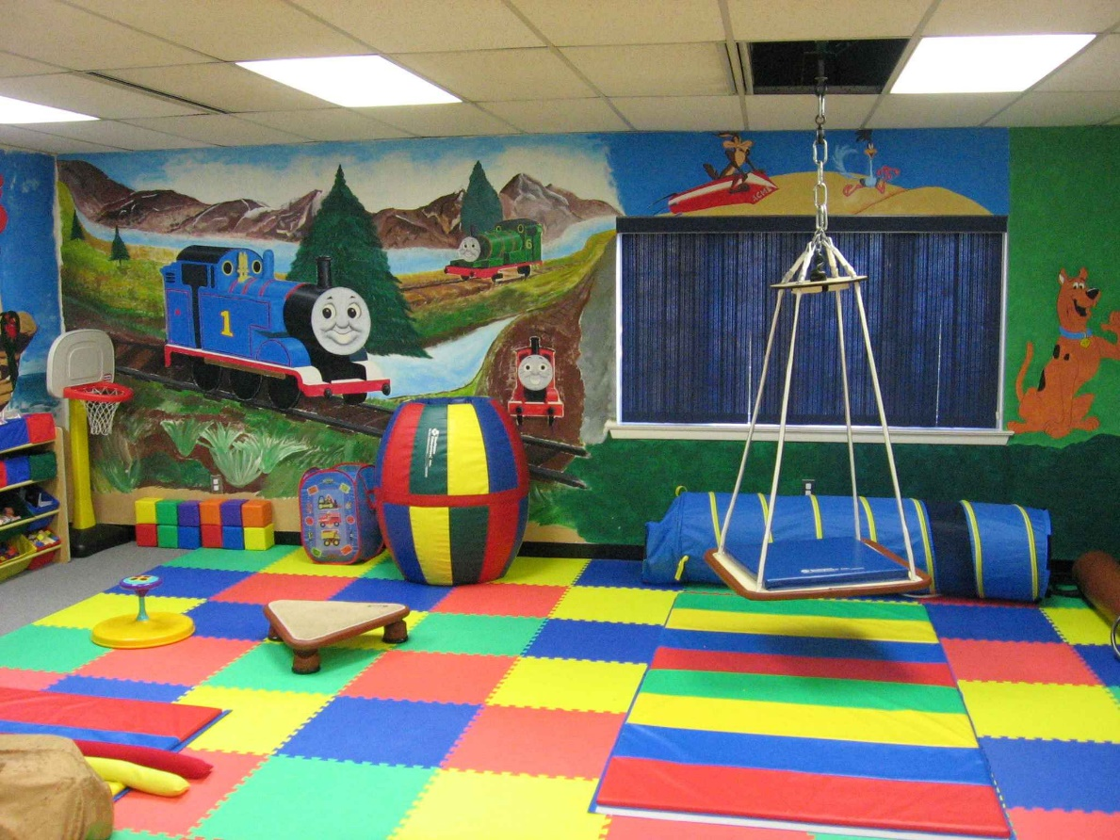
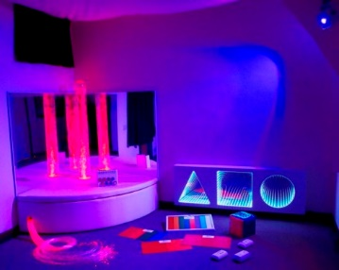
Providing sensory regulating spaces

Slide 12
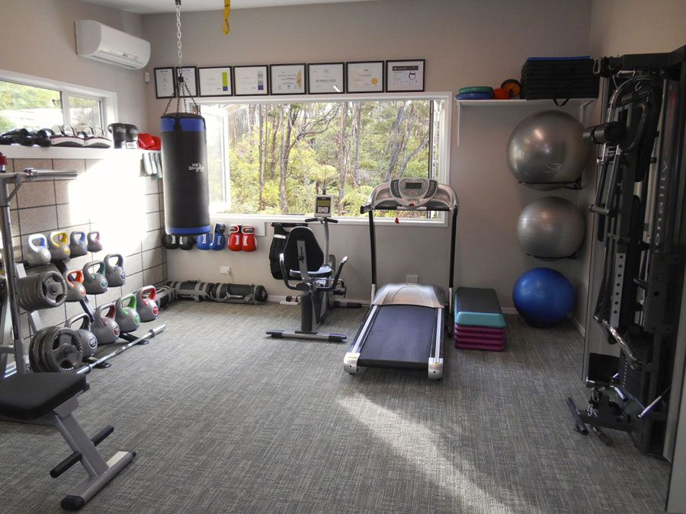
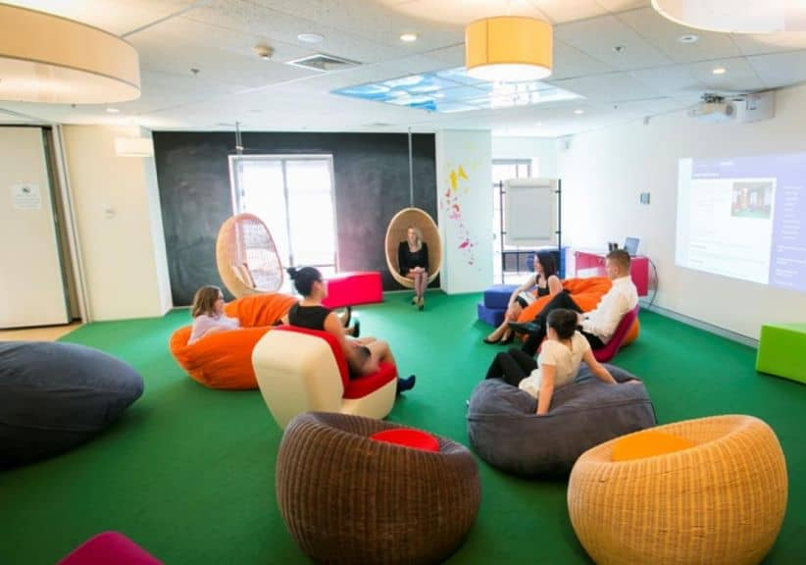
Providing sensory regulating spaces

Slide 13
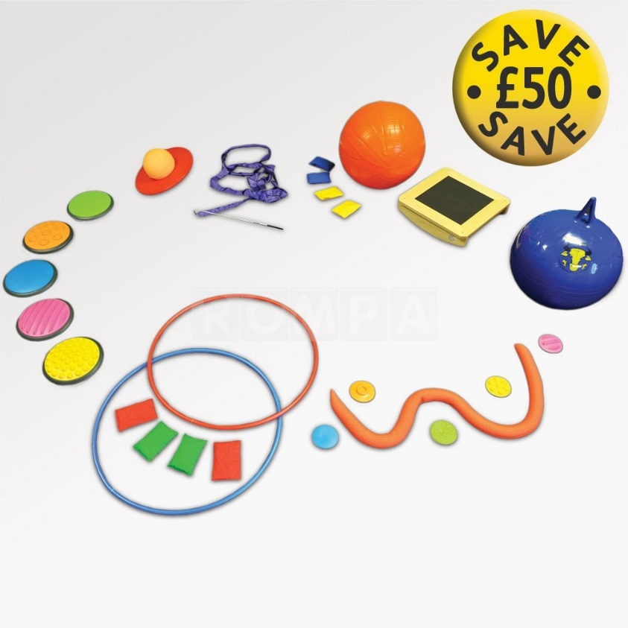
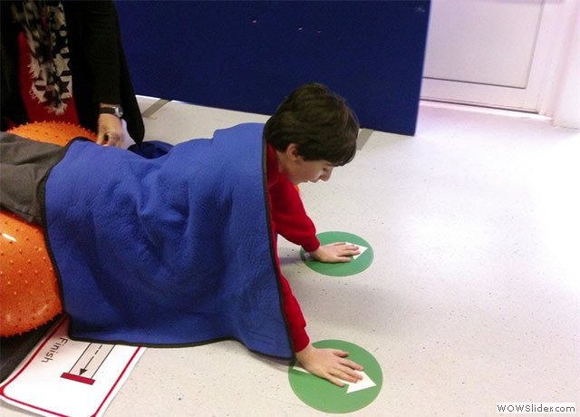
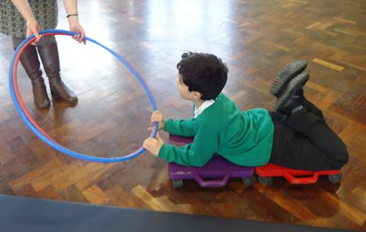
Sensory circuits
Quick!
Easy!
Develop balance and core strength
Focus on vestibular and proprioceptive sense
Calming impact

Slide 14


Slide 15
Example Risk Assessment
Assessment for: X | Completed by: Kate Rogers |  |  | Date: | Date for review:
Factor / Hazard: Incidental close proximity or touching between X and peers or staff
Proactive measures (to prevent risk) X to have his/her own working environment where possible Established workstation area in classroom where X is used to working. 1 adult to 1 child ratio for [child] within school Handover between parent/carers & 1:1 during drop off and pick up times. X to be dropped off and picked up by parent/carer at an arranged staggered time. Staggered break and lunch times Ensure staff working with X are aware of his individual needs Ensure that X is aware of the new rules and reasons behind it through use of a social story/ symbols etc Provide visual timetable to support X with new routines |  |  | Reactive measures (to respond to risk) Use Visual prompts to remind X of social distancing rules Staff to have suitable PPE to hand and use if required. Ensure regular handwashing and hygiene routines take place throughout the day Have sensory alternatives available if X is seeking close contact (see sensory alternatives in additional comments)
Who is at risk? X and 1:1 staff |  | Risk Low / Medium / High | Action by and date:

Slide 16
Example Risk Assessment
Assessment for: X | Completed by: Kate Rogers |  |  | Date: | Date for review:
Factor / Hazard: Mouthing objects
Proactive measures (to prevent risk) X to have access to his own resources Resources not to be shared between children Provide sensory alternatives such as chewies to avoid mouthing of other equipment |  |  | Reactive measures (to respond to risk) Use of symbols to remind X not to put items in his/her mouth Stringent hygiene routine with all equipment/ resources used by X
Who is at risk? X and 1:1 staff |  | Risk Low / Medium / High | Action by and date:

Slide 17
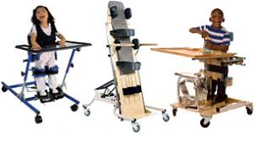
Physical needs
Issues due to appointment cancellations/ lack of access to services
Important to note concerns and date
Support parents to chase up any concerns
Liaise with other professionals

Slide 18
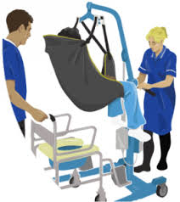
Physical needs
Social distancing not possible if child requires physical support
Risk assessment vital
Use of PPE equipment
Intimate care/personal care

Slide 19
Example Risk Assessment
Assessment for: X | Completed by: Kate Rogers |  |  | Date: | Date for review:
Factor / Hazard: When SXis using walking frame/ requiring support with transfers/ delivering physio
Proactive measures (to prevent risk) |  |  | Reactive measures (to respond to risk)
Agree a specific time for the pupil to arrive in school that avoids other large groups of children (e.g. 10 mins after rest of school arrive). Arrange for pupil to be met by staff with suitable access to hygiene measures e.g. wipes for wheelchair handles Arrange for pupil to be seated close to entrance/exit to classroom Encourage teaching staff to be flexible on timing of lessons so additional time can be allowed for change of place. Avoid distance walking wherever possible. Use wheelchair for longer distances Provide the Pupil with single use gloves to wear (if tolerated) when transferring from one place to another, to reduce their risk of infection. Provide staff with appropriate PPE/ wipes/ hand gel to maintain appropriate hygiene standards Allocate a regular 1:1 to support X where possible to minimise risk of infection spread Provide pupil with hand gel to avoid continual bathroom trips Staff to use appropriate PPE when close contact is required Staff to be trained in appropriate moving and handling |  |  | Carry anti-bacterial wipes, hand gel and PPE equipment at all times when moving around school Encourage independence where possible e.g. Using tables for support with transfer, holding on to bars or walls in the bathroom
Who is at risk? X and staff supporting |  | Risk Low / Medium / High | Action by and date:
Additional Information X will likely use her wheelchair for the majority of the time but will need support for transfers and if she decides to use her waking frame around school. Supporting staff should be aware and comfortable with the fact that social distancing with X is not always possible.

Slide 20
Example Risk Assessment
Assessment for: Child that requires full support with intimate care | Completed by: |  |  | Date: | Date for review:
Factor / Hazard: Child with intimate care needs
Proactive measures (to prevent risk) |  |  | Reactive measures (to respond to risk)
Ensuring suitable PPE is available for every change. Either providing one space that only that child will be changed in or arranging deep clean of the area after each change. Parental consent for intimate care and writing of individual intimate care plan. Agreement from parents that they will come to school to change the child if the child becomes distressed. Prepare preferred resources to distract the child whilst changing to avoid unnecessary distress. |  |  | Wear suitable PPE including gloves, apron and mask. 2 members of staff to support with changing the child. Stringent hygiene measures throughout. If child becomes upset by the process parent to be called to change child.
Who is at risk? Members of staff administering |  | Risk Low / Medium / High | Action by and date:
Additional Information

Slide 21
Any Questions?
?
Individual cases
Risk assessment support
Sensory ideas
What has worked well in your settings already?

Slide 22
Thank you for your time
Please stay in touch:
K.rogers@pennhall.co.uk
Tel: 01902 558371
www.wolverhampton.gov.uk/outreach
 | WOLVERHAMPTON OUTREACH SERVICE SUPPORTING SCHOOLS. ENABLING INCLUSION.

